Slide 1

Dataverse + Power BI Create real-time and contextualized analytics and reports in your apps
Scott Sewell
Microsoft

Slide 2




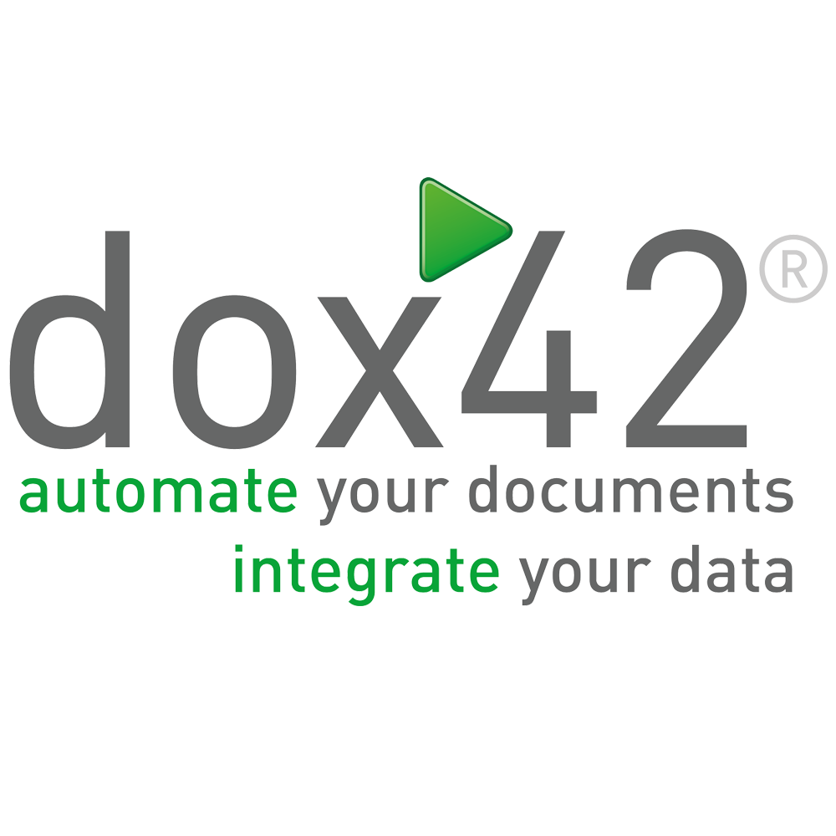

Thank You to our Sponsors…
Event Sponsor
Platinum Sponsors

Slide 3








Thank You to our Sponsors…
Gold Sponsors
Data Quality
Event Lunch
Accessibility
Data Analytics

Slide 4




Speaker Scott Sewell
Principal Program Manager
Microsoft
20 Years Experience with Power Platform (CRM 1.0 Beta in 2002)
BizApps/Dynamics MVP for 9 Years before joining MSFT
Power BI CAT member focused entirely on bringing Power BI Analytics to the Dataverse
Mildly obsessed with a Dynamics 365 Titanic demo
Passionate about Empowering Citizen Developer Data Scientists
M Scott Sewell | LinkedIn
Scott Sewell (@scottsewell) / Twitter
MScottSewell (Scott Sewell) · GitHub

Slide 7
As a Dynamics, Power Apps, Dataverse Expert: Why should I care?
Expand the usability and value of your apps
Add a 360º overview for users / managers
Dataverse data – Without 50K row limits
External data – Combine without lift-and-shift
Contextual Reports
360º View from within an individual record
Finally – The real benefit:
Power BI is the best way to expose the value of the data in your app to Business Decision Makers
Increase speed and completeness of adoption
Built-in Artificial Intelligence over your data

Slide 8
Agenda
Power BI integration in Model-Driven Power Apps/Dynamics 365 CE
Reporting options on Dataverse data
Connecting Power BI to Dataverse
Resources
Using Azure Synapse Link for Dataverse

Slide 9
Power BI integration in Power Apps & Dynamics 365

Slide 10
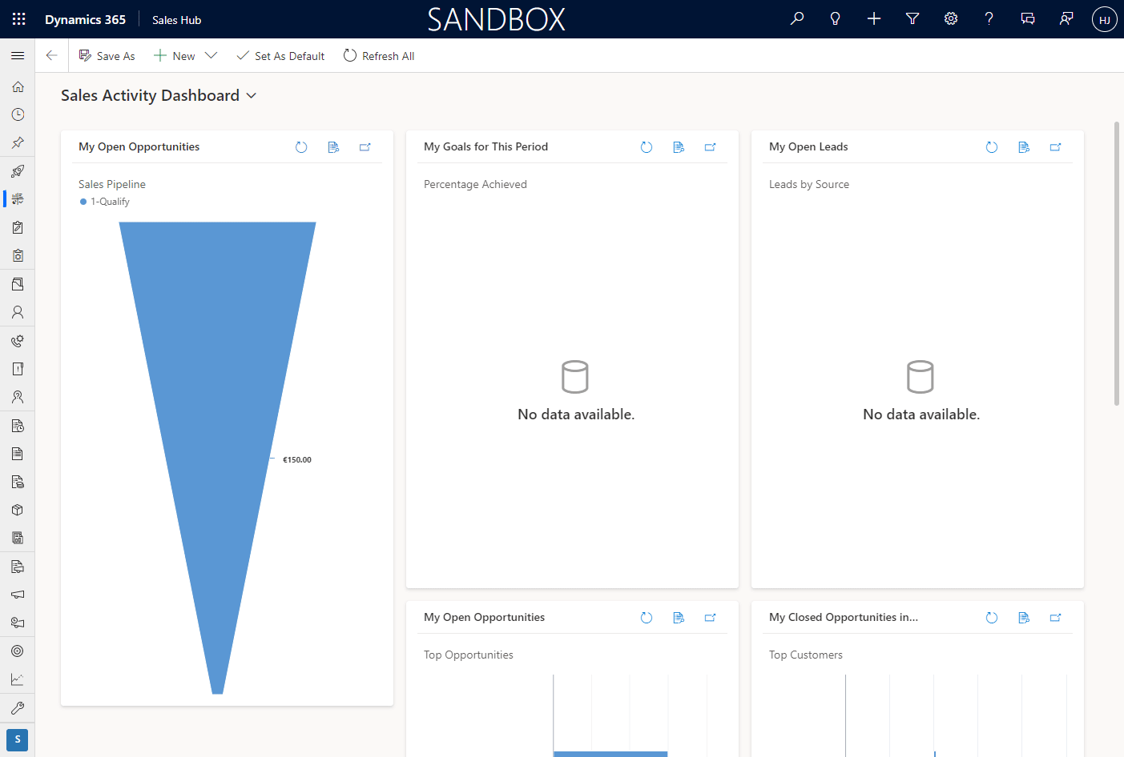
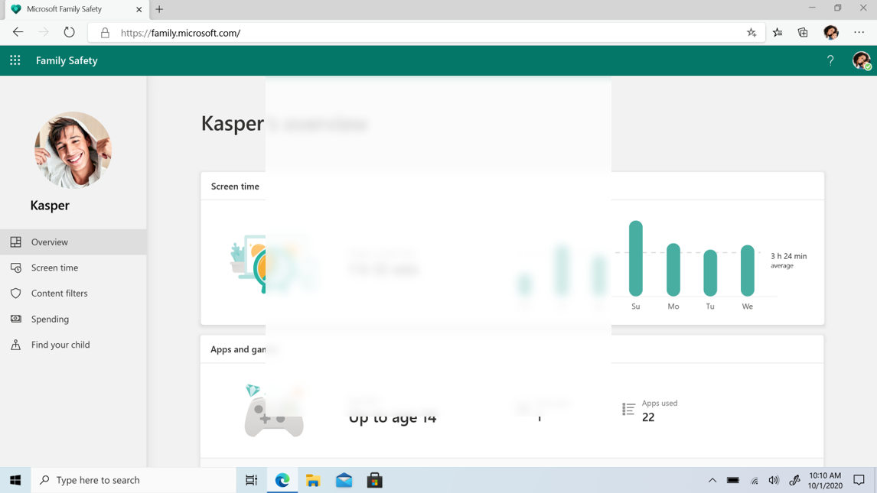
Displaying a Power BI report in a dashboard
Welcome your app users with user-contextualized insights.
Act on the data presented in the report by integrating flows and canvas app visuals.

Slide 11
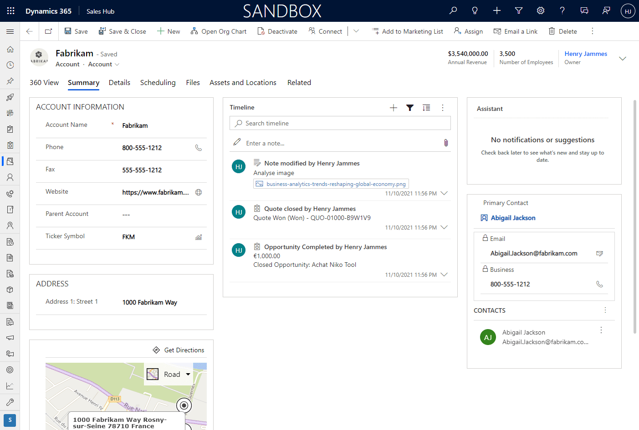
Displaying a Power BI report in a main form
Reports in forms can be contextualized to the record, offering a 360 view.
Multiple data sources can be used to visualize data beyond what is stored in Dataverse.

Slide 12
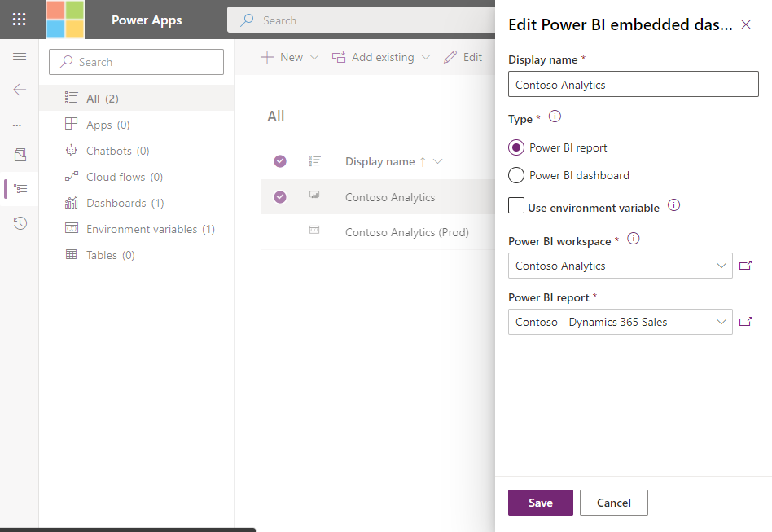
Embedding a Power BI report into a dashboard
Official documentation:
Create or edit a Power BI embedded system dashboard
Use environment variables to point to different Power BI workspaces and reports in dev/test/prod etc.

Slide 13
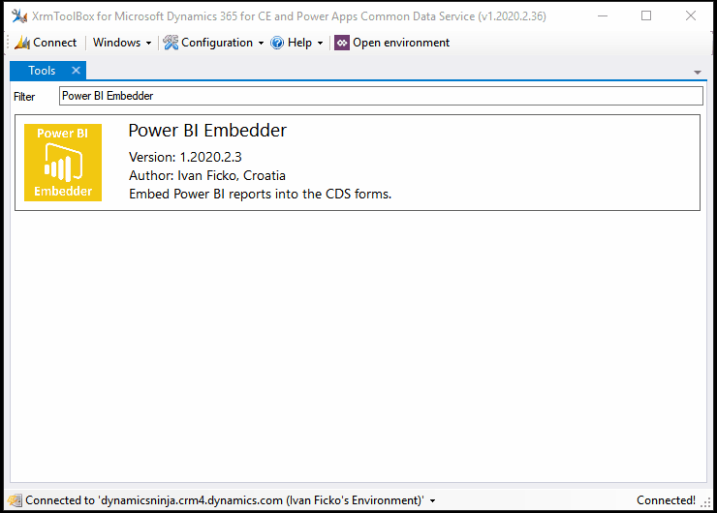


Embedding a Power BI report into a main form
Official documentation:
Embed a Power BI report in a model-driven app main form
Easiest way: XrmToolBox and the Power BI Embedder tool
Power BI Embedder for XrmToolBox - Dynamics Ninja
Ivan Ficko

Slide 14
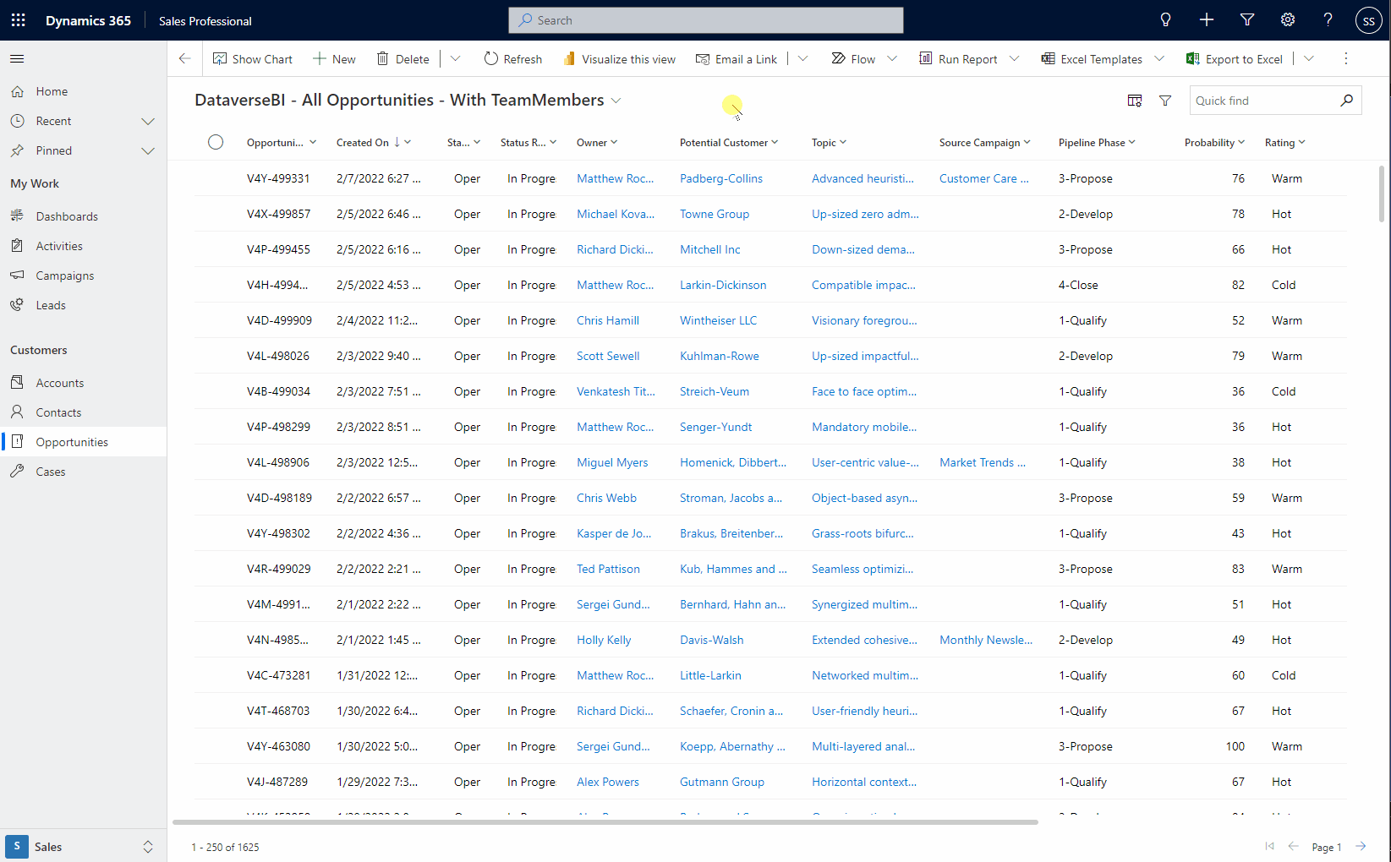
Power BI Quick Reports in Dataview (Preview)
Create a Power BI report from within a Dataverse View.
Report can be customized (but not yet saved)
Enabled ‘per app’ in Maker Portal
Display names are coming soon

Slide 15
Power BI in Power Apps & Dynamics 365
Platform | Component | Power BI Report | Power BI Dashboard | Power BI Dashboard Tile
Power Apps | System dashboard | ✅ | ✅ | ❌
 | Personal dashboard | ❌ | ✅ | ✅
 | Main form | ✅ | ❌ | ✅
 | Custom page (Coming Soon) | ❌ | ❌ | ❌
 | Canvas app | ✅ | ❌ | ✅
 | Portal | ✅ | ✅ | ✅
Power Apps and Power Automate in Power BI
Power BI | Power Apps canvas app | Power Automate cloud flow
Report visual | ✅ | ✅

Slide 16
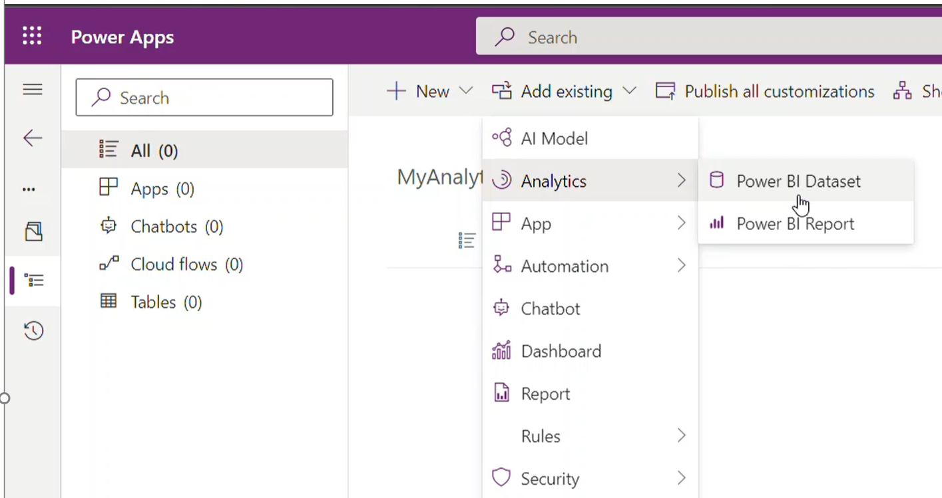
Solution Aware Power BI in Power Apps Solutions
Ship Power BI content in a Power Apps Solutions across environments & tenants.
Add to Solution.
Makers can add Power BI content to a solution along with the content.
One Click Deployment
Importing a Power Apps Solution deploys content to dedicated environment workspace in Power BI.
Customization
Customize Power BI content with ease to fit the organization/department analytics needs.

Slide 17
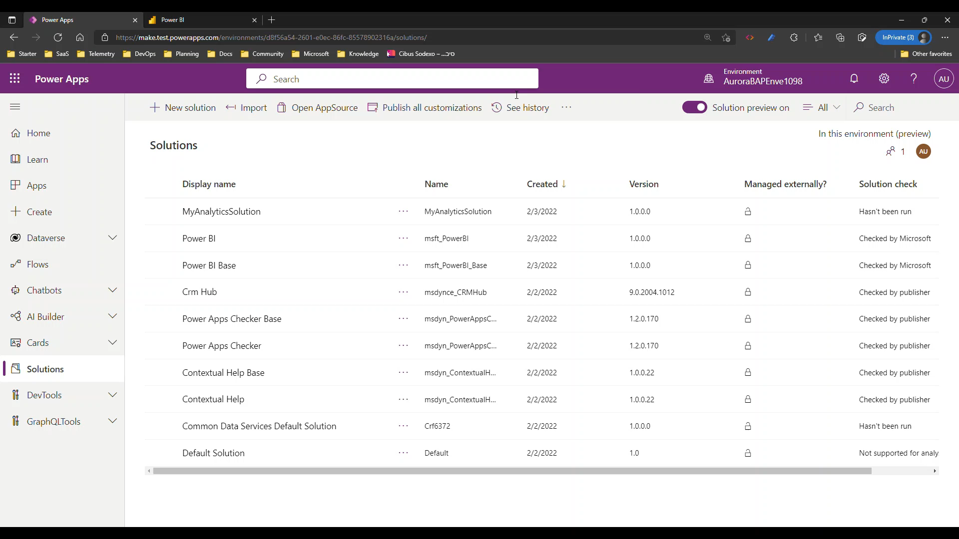
Solution Aware Power BI in Power Apps Solutions
Ship Power BI content in a Power Apps Solutions across environments & tenants.

Slide 18

Reporting options on Dataverse data

Slide 19


Reporting options on Dataverse data
Dataverse + DirectQuery
Individual user’s own data (security model applies)
Best for targeted datasets <50K rows returned
Dataverse + Import Mode
Scheduled refreshes of medium-sized datasets <100K rows returned
Faster rendering/responsiveness of reports
Azure Synapse Link for Dataverse
Enterprise-Scale data source for reporting
Incremental refresh is possible if carefully managed
Enrichment through Machine Learning
Run-time query for current data – real-time-ish
Integration with Data Warehouse
Power BI DataMart (preview)
Power Query ETL into a SQL database
Combine with other sources to create a rich Data Source for Reporting

Slide 20
Connecting Power BI to Dataverse

Slide 21
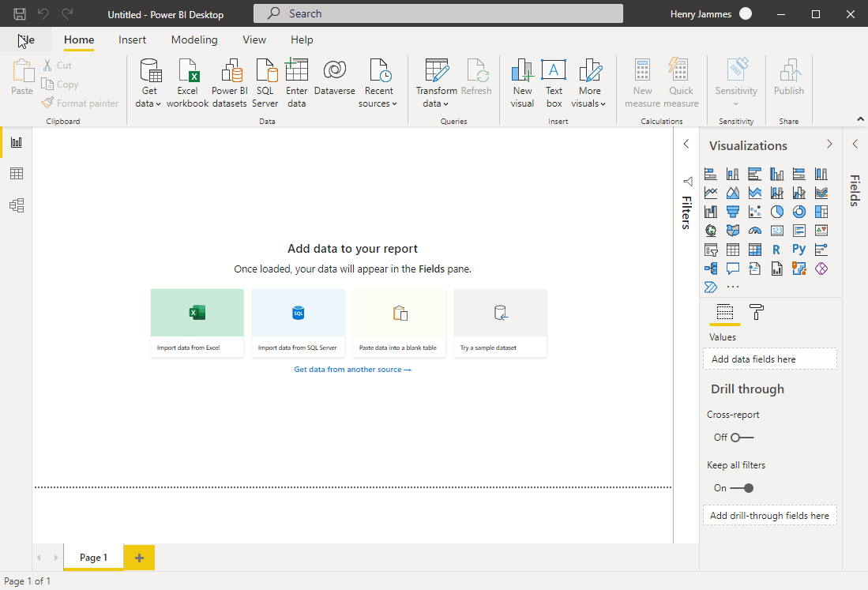
Dataverse connector in Power BI
Easiest way to get started for citizen report makers, thanks to the environment picker.
Important to transform data in Power Query to remove all unnecessary columns and filter your data.
Verify query folding, to optimize performance.

Slide 22
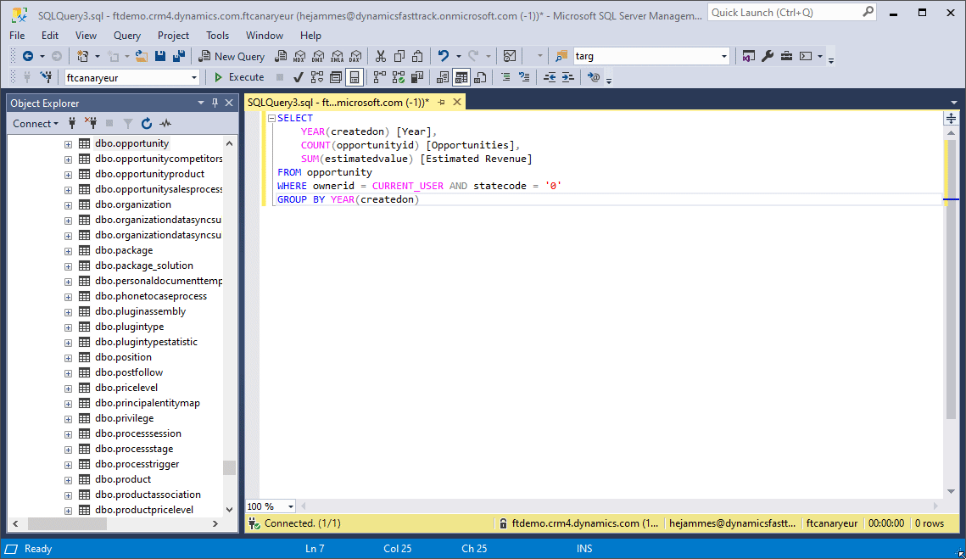
Creating Dataverse SQL-based Power BI reports
Fast and ideal for report makers who prefer SQL as a query language.
Datasets can be prepared with aggregates, joins and filters.
Use the CURRENT_USER variable to replicate the “My …” (Accounts, etc.) filtered views.

Slide 23
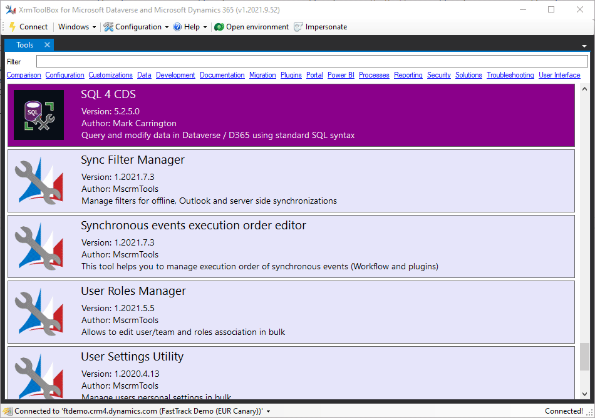

Preparing your Dataverse SQL statements
Use SQL Server Management Studio (SSMS)
Use SQL to query data (Microsoft Dataverse)
XrmToolBox and SQL 4 CDS tool
SQL 4 CDS XrmToolBox Tool - Mark Carrington
Mark Carrington

Slide 24

DirectQuery best practices
Stay focused on use case
Embrace a Star Schema
Minimize query columns
Leverage the Query Editor
Take advantage of the hints
Avoid large blocks of text
Minimize choice labels
Consider dual-mode dims
Ensure the Query is Folding
Don’t forget the checkbox
What topic area is this report supporting?
Who is the audience of this report?
What question is the report trying to answer?
What’s the MVD - Minimum Viable Dataset?

Slide 25


DirectQuery best practices
Stay focused on use case
Embrace a Star Schema
Minimize query columns
Leverage the Query Editor
Take advantage of the hints
Avoid large blocks of text
Minimize choice labels
Consider dual-mode dims
Ensure the Query is Folding
Don’t forget the checkbox

Slide 26
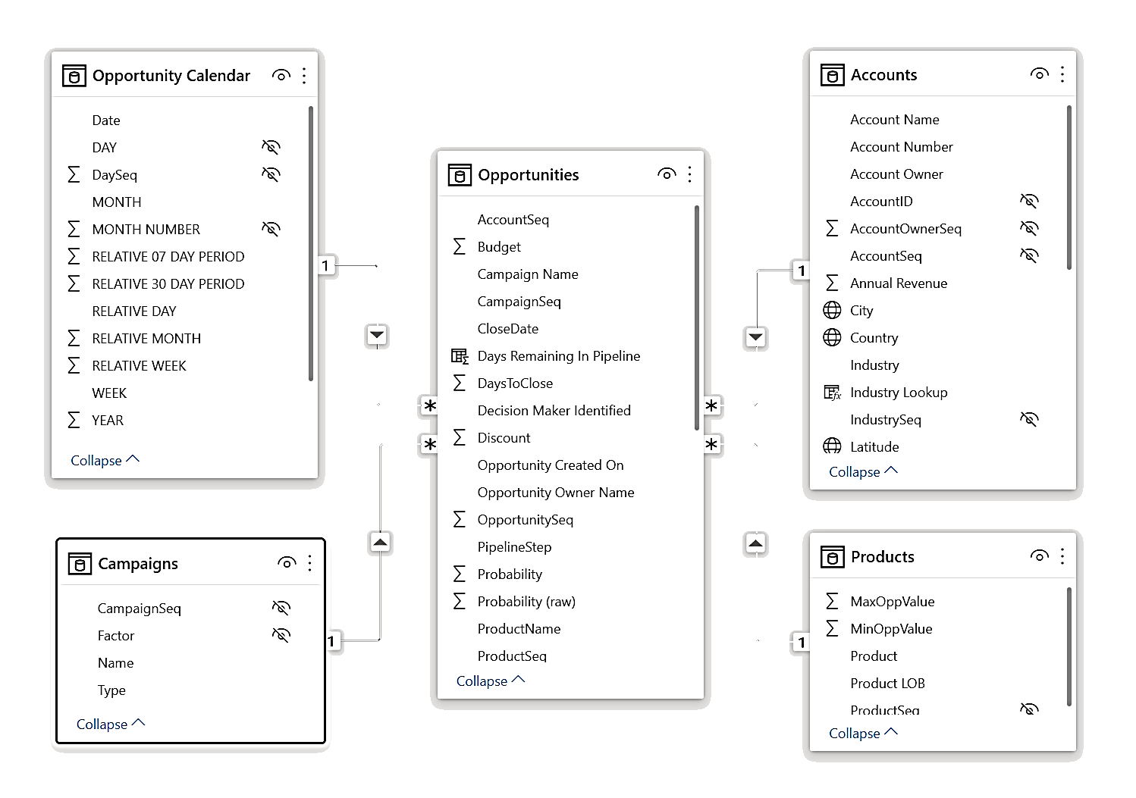





DirectQuery best practices
Stay focused on use case
Embrace a Star Schema
Minimize query columns
Leverage the Query Editor
Take advantage of the hints
Avoid large blocks of text
Minimize choice labels
Consider dual-mode dims
Ensure the Query is Folding
Don’t forget the checkbox
Dimension
Dimension
FACT
Dimension
Dimension
Understand star schema and the importance for Power BI

Slide 27
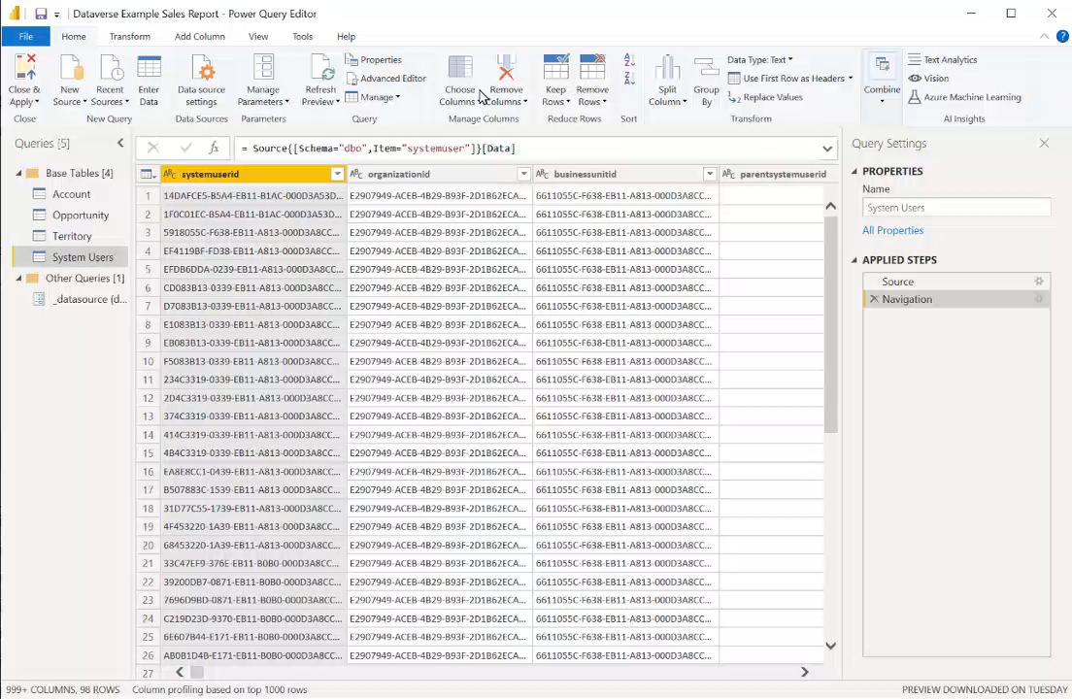
DirectQuery best practices
Stay focused on use case
Embrace a Star Schema
Minimize query columns
Leverage the Query Editor
Take advantage of the hints
Avoid large blocks of text
Minimize choice labels
Consider dual-mode dims
Ensure the Query is Folding
Don’t forget the checkbox

Slide 28
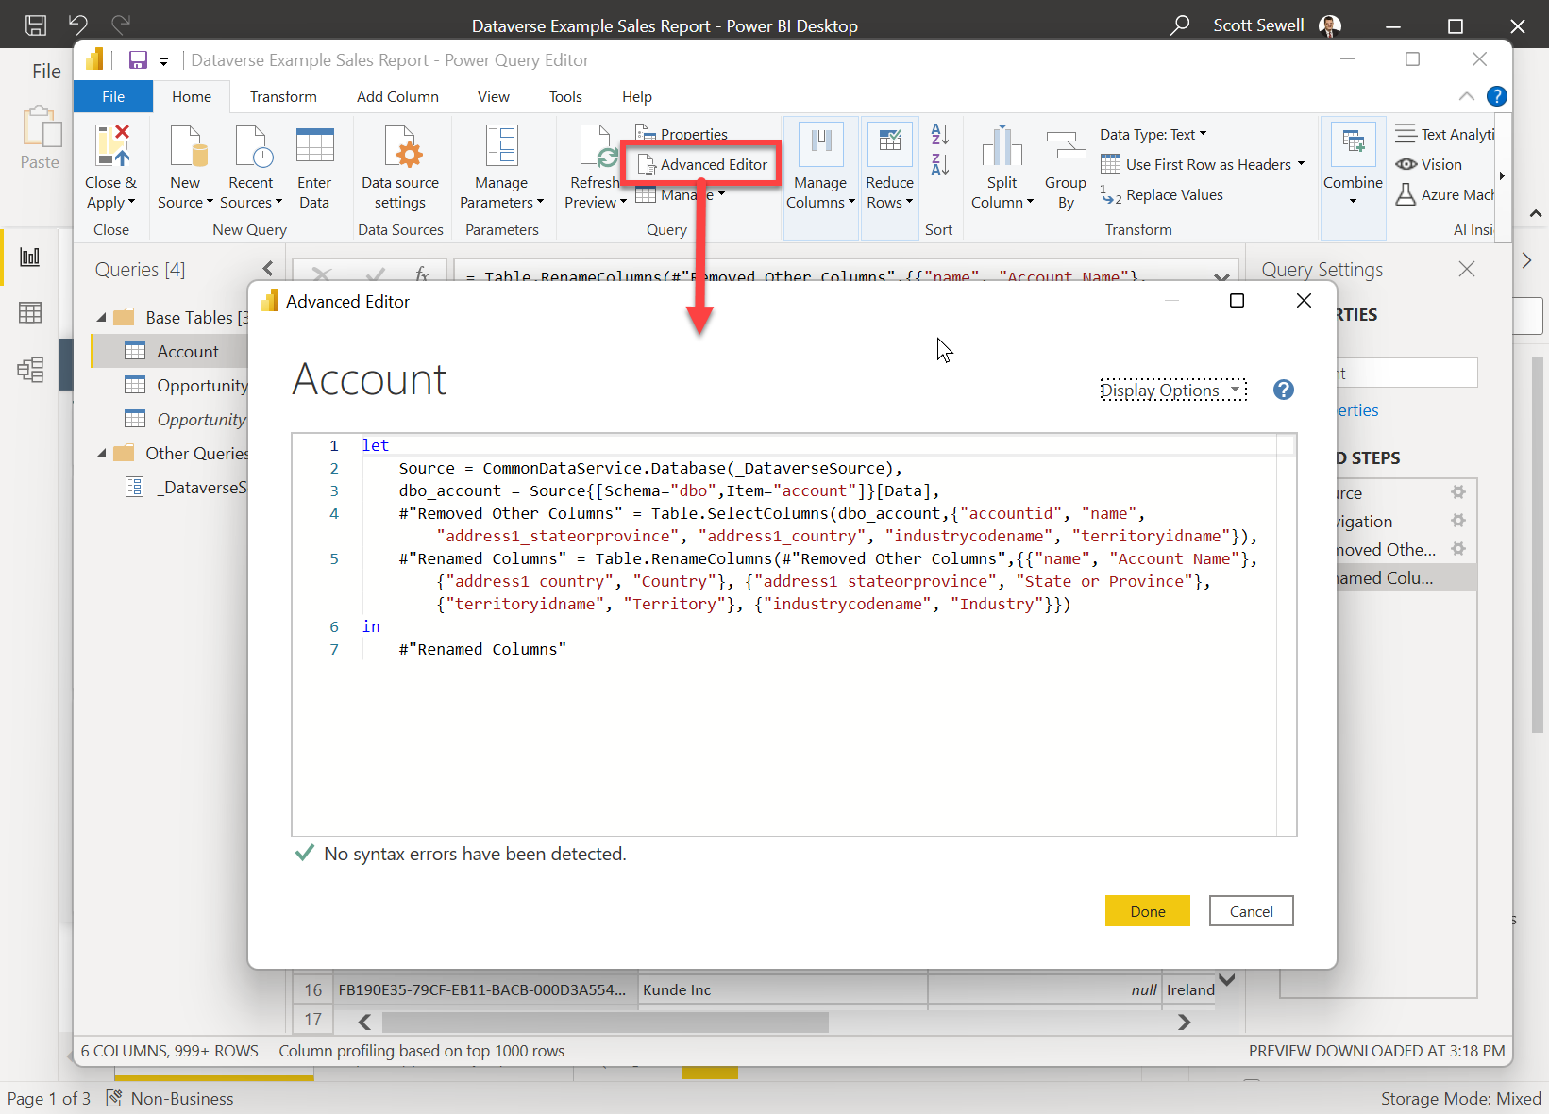
DirectQuery best practices
Stay focused on use case
Embrace a Star Schema
Minimize query columns
Leverage the Query Editor
Take advantage of the hints
Avoid large blocks of text
Minimize choice labels
Consider dual-mode dims
Ensure the Query is Folding
Don’t forget the checkbox
With large tables, build the query in the Query Editor. A simple query will get you started and allow you to build up the query quickly and ‘safely’.

Slide 29
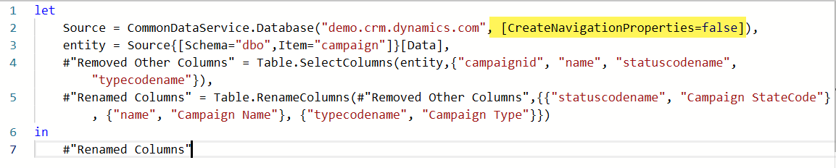
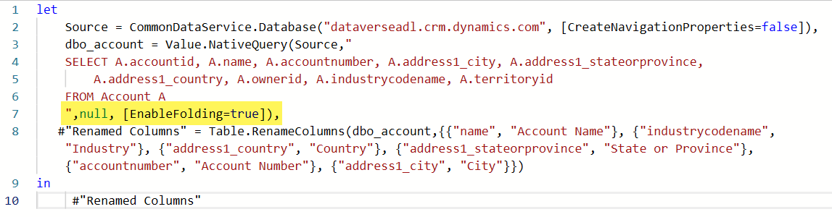
DirectQuery best practices
Add the hint "[CreateNavigationProperties=false]" to ignore the table's relationship metadata from Dataverse.
This can dramatically speed up report load times in the editor.
Stay focused on use case
Embrace a Star Schema
Minimize query columns
Leverage the Query Editor
Take advantage of the hints
Avoid large blocks of text
Minimize choice labels
Consider dual-mode dims
Ensure the Query is Folding
Don’t forget the checkbox
If you’re using a native query against Dataverse, add the ‘EnableFolding=true’ hint to allow Power Query to off-load more of the processing and filtering work to Dataverse and improve refresh times.

Slide 30
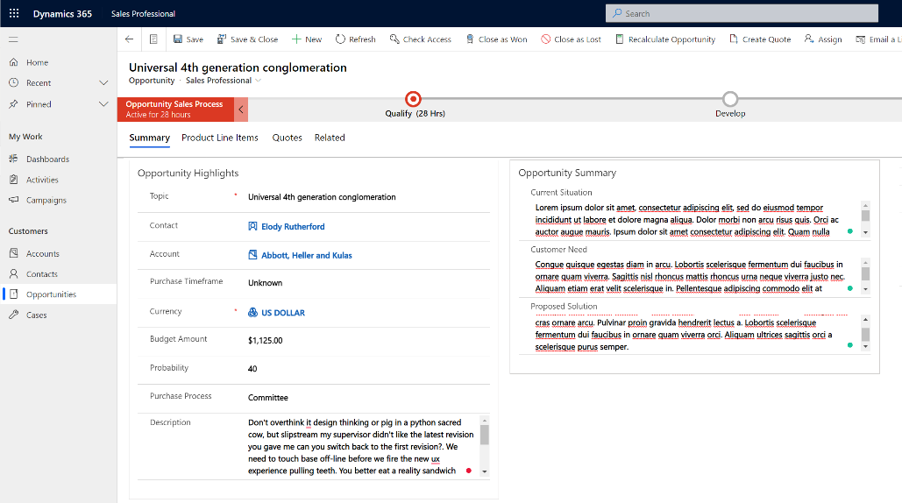


DirectQuery best practices
Stay focused on use case
Embrace a Star Schema
Minimize query columns
Leverage the Query Editor
Take advantage of the hints
Avoid large blocks of text
Minimize choice labels
Consider dual-mode dims
Ensure the Query is Folding
Don’t forget the checkbox

Slide 31
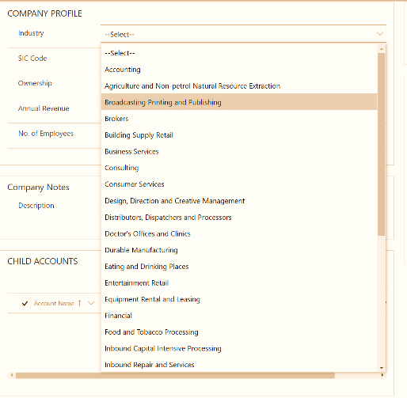

DirectQuery best practices
Whenever possible, filter the dataset on the numeric value of a choice column, rather than the string.
Normally a few choices are fine, but if there are a dozen or more being pulled in the query, consider returning only the integer value from Dataverse and using a calculated field to apply the label inside Power BI. – This improves speed and reduces the overall size of the query results.
Stay focused on use case
Embrace a Star Schema
Minimize query columns
Leverage the Query Editor
Take advantage of the hints
Avoid large blocks of text
Minimize choice labels
Consider dual-mode dims
Ensure the Query is Folding
Don’t forget the checkbox

Slide 32
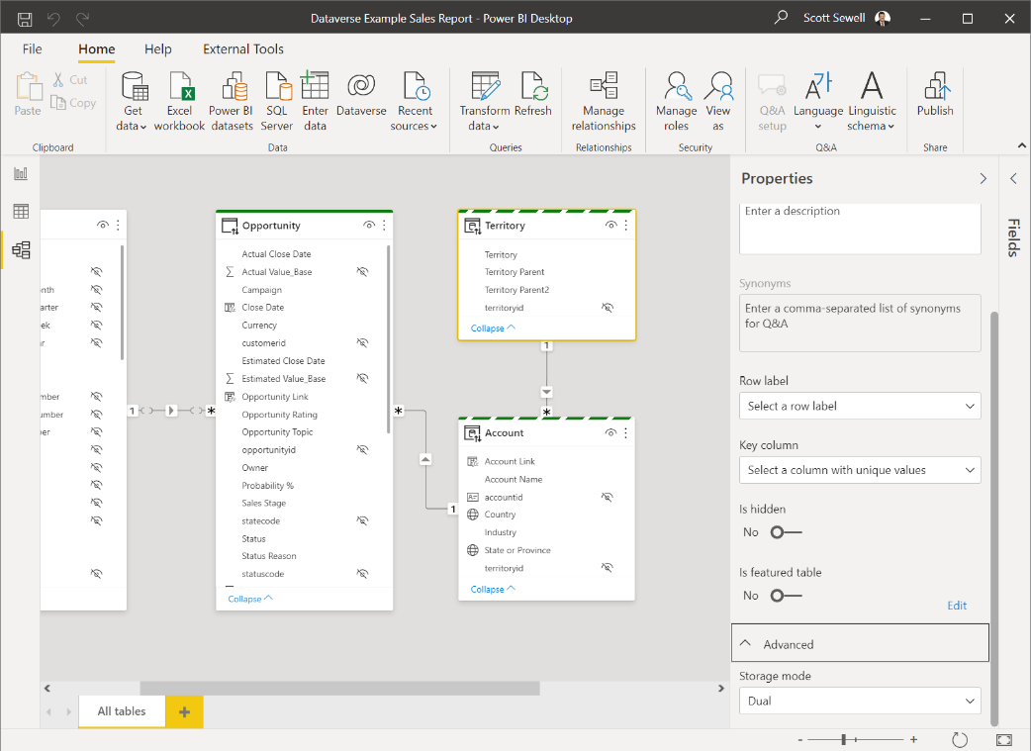
DirectQuery best practices
Stay focused on use case
Embrace a Star Schema
Minimize query columns
Leverage the Query Editor
Take advantage of the hints
Avoid large blocks of text
Minimize choice labels
Consider dual-mode dims
Ensure the Query is Folding
Don’t forget the checkbox

Slide 33
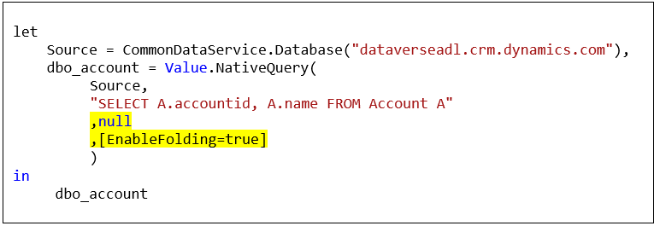
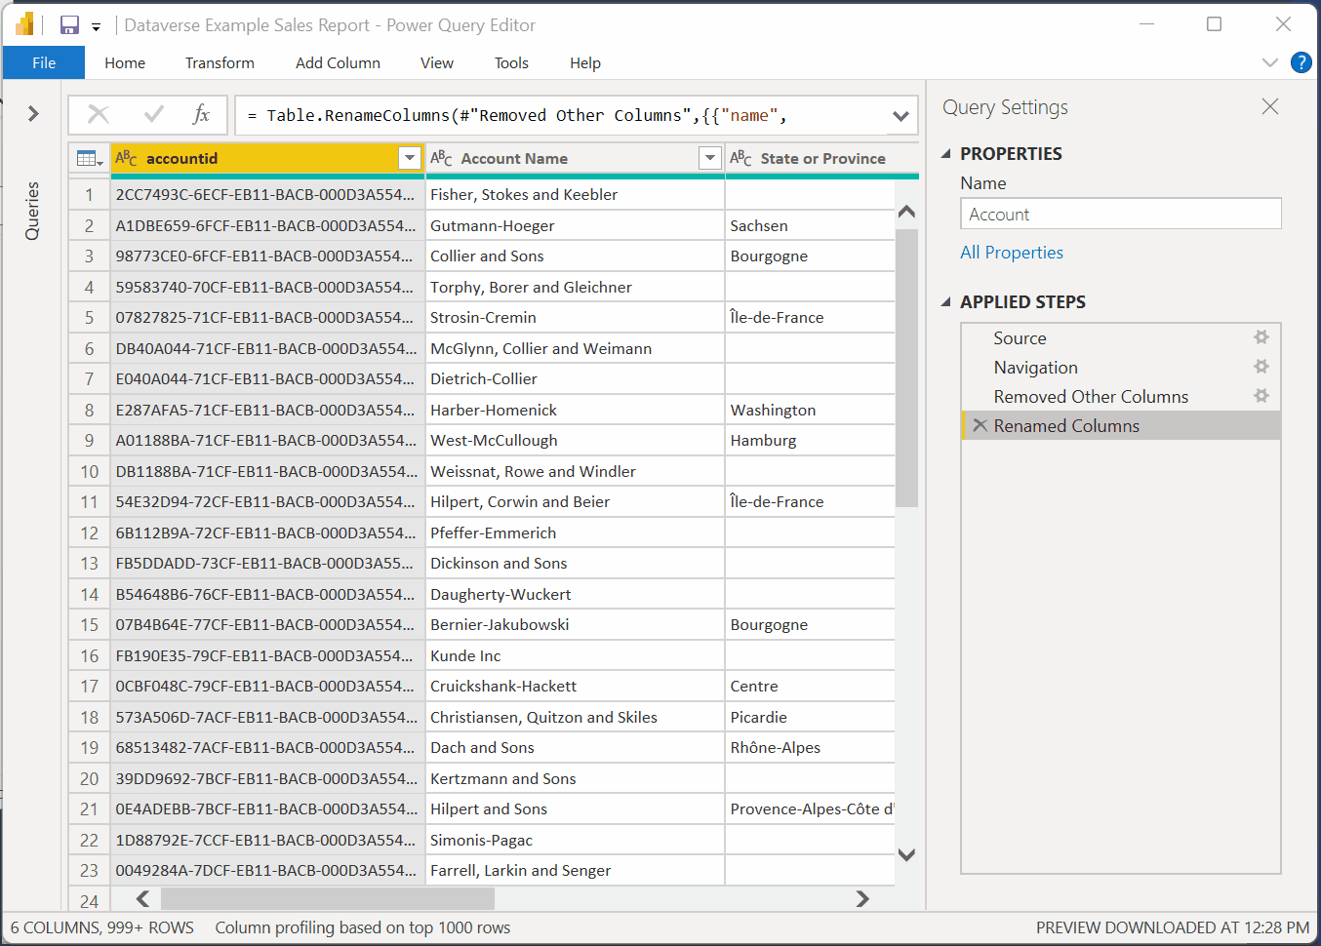
DirectQuery best practices
Stay focused on use case
Embrace a Star Schema
Minimize query columns
Leverage the Query Editor
Take advantage of the hints
Avoid large blocks of text
Minimize choice labels
Consider dual-mode dims
Ensure the Query is Folding
Don’t forget the checkbox
If you’re using a native query, add the ‘EnableFolding=true’ hint.
https://docs.microsoft.com/en-us/power-query/power-query-folding

Slide 34
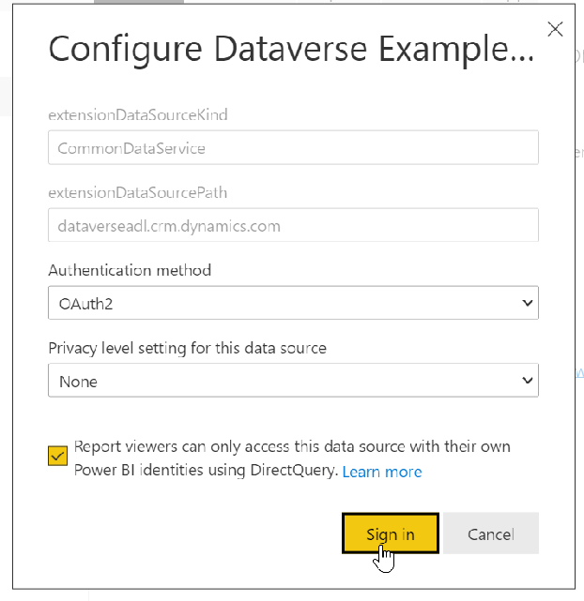
DirectQuery best practices
After Publishing the Report, you’ll need to set up the credentials for the dataset.
Be sure to click the checkbox to ensure report viewers will see the report filtered to the data they have permission to see within Dataverse.
Stay focused on use case
Embrace a Star Schema
Minimize query columns
Leverage the Query Editor
Take advantage of the hints
Avoid large blocks of text
Minimize choice labels
Consider dual-mode dims
Ensure the Query is Folding
Don’t forget the checkbox

Slide 35
Dataverse connector in Power Query
Benefits:
Available directly in Power BI (and Excel in a future release).
DirectQuery support
Real-time
User security context is applied
Dataverse SQL support
Considerations:
TDS endpoint limits apply
80-MB maximum for query results
Unsupported datatypes and tables (image, file, multi-choice, audit, etc.)
Dates are formatted as UTC.
Plug-ins registered on the RetrieveMultipleRequest or RetrieveRequest messages are not triggered
Import Mode Support
Highly responsive user interactions
Lowered complexity of query

Slide 36

Azure Synapse Link For Dataverse
Azure Synapse Link - Power Apps | Microsoft Docs

Slide 37
SQL Data Export Service
Effective November 2021, the SQL Data Export Service was deprecated.
Data Export Service will continue to work and will be fully supported until it reaches end-of-support and end-of-life in November 2022.
More information: https://aka.ms/DESDeprecationBlog

Slide 38
Azure Synapse Link for Dataverse
Azure Synapse Analytics
Auto-Created Views
Azure Synapse Link for Dataverse
Power BI
Azure Data Lake Storage

Slide 39
Azure Synapse Link for Dataverse
Azure Synapse Analytics
Auto-Created Views
Custom Report Views
Azure Synapse Link for Dataverse
Power BI
Azure Data Lake Storage

Slide 40
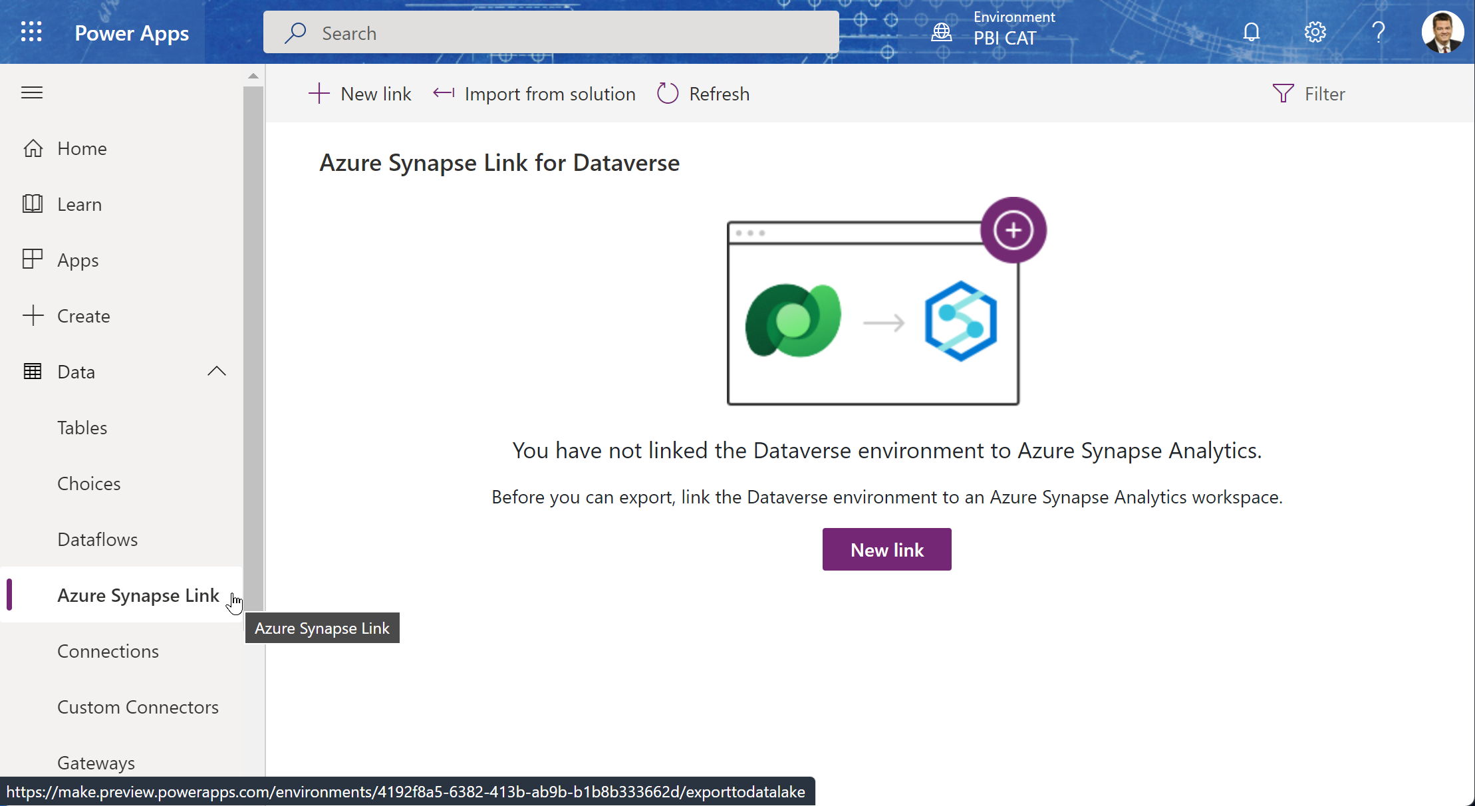
Setup of Synapse Link
Power Apps Administration Page
Https://make.PowerApps.Com

Slide 41
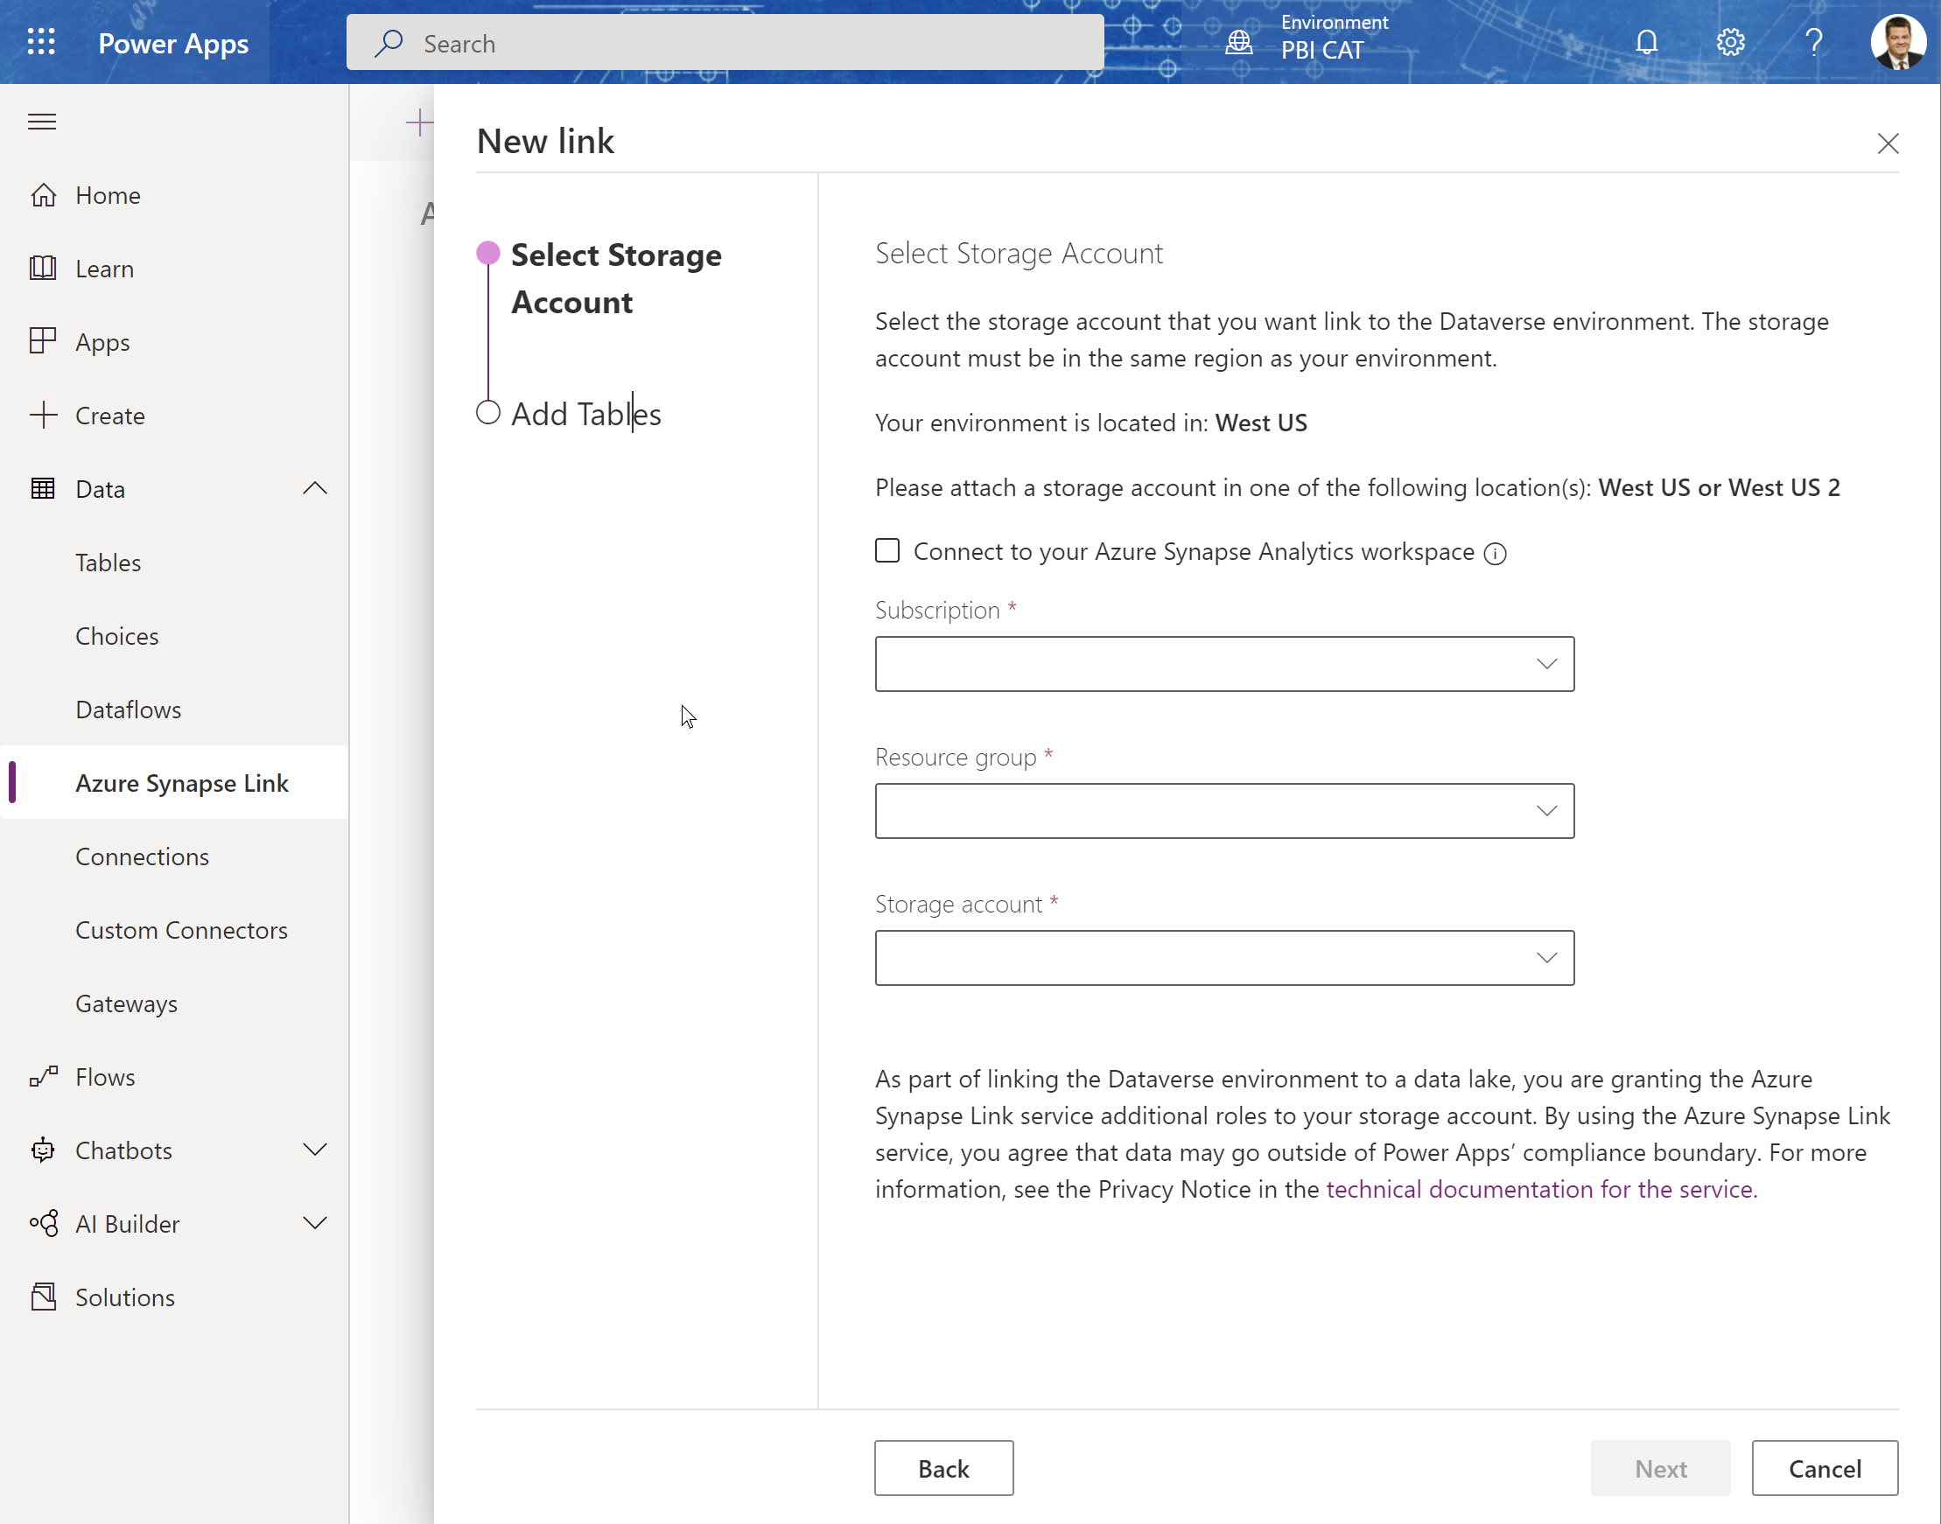
Create Synapse Link
Choose the Storage account and Synapse workspace:
If you already have a Synapse Workspace, click the checkbox to connect to the existing workspace.

Slide 42
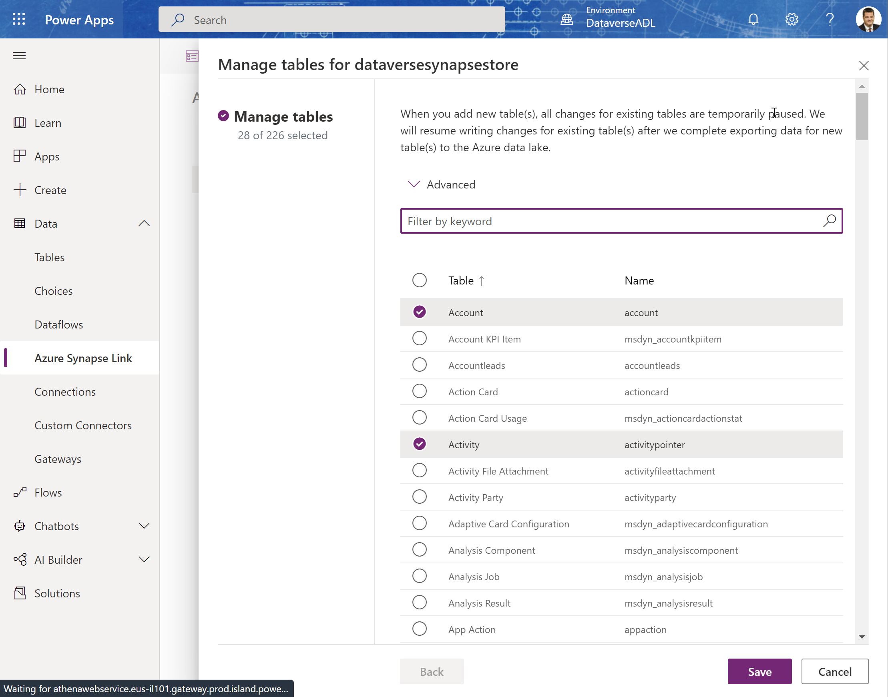
Choose Tables
Choose the tables you want to sync to the Azure data lake – (you can add more later.)

Slide 43
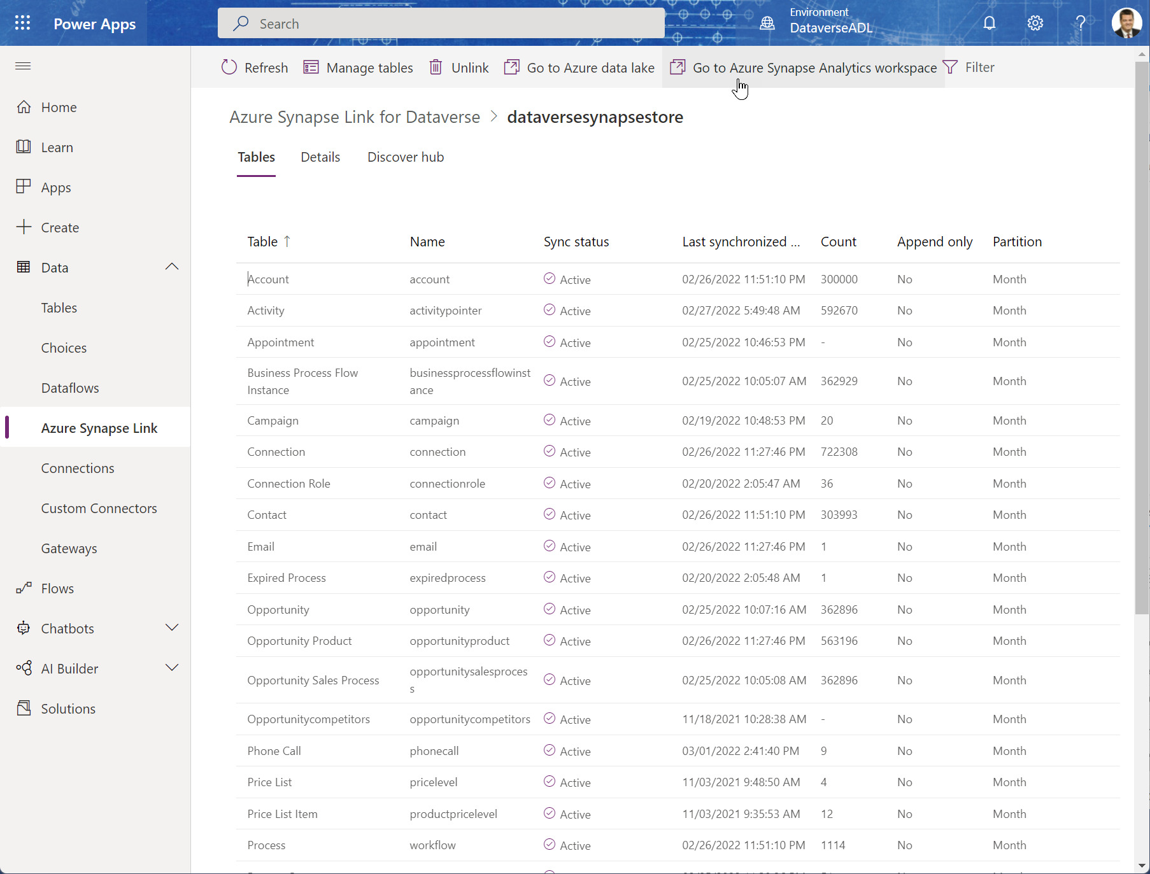
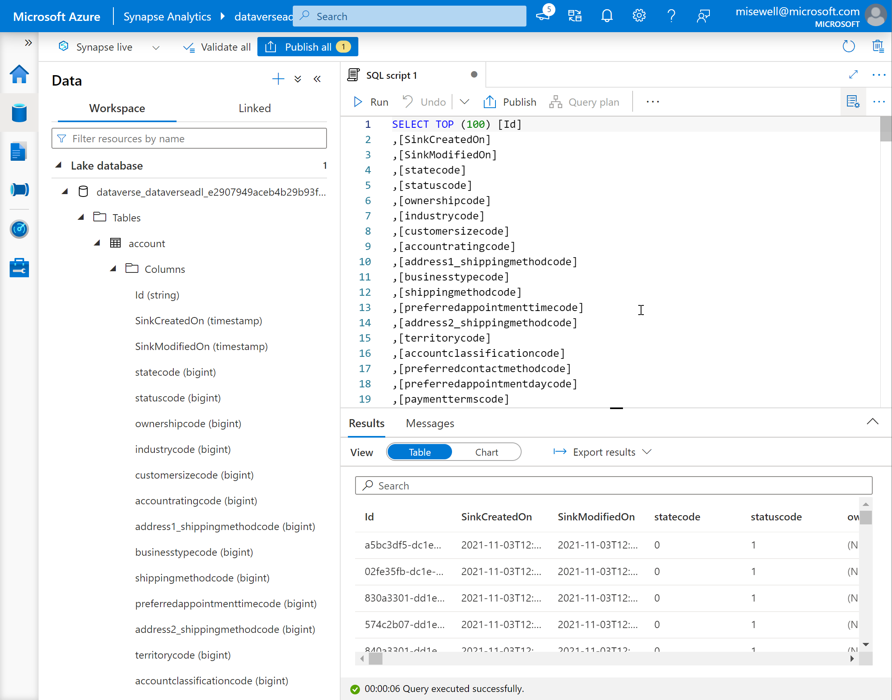
Open Synapse Workspace

Slide 44
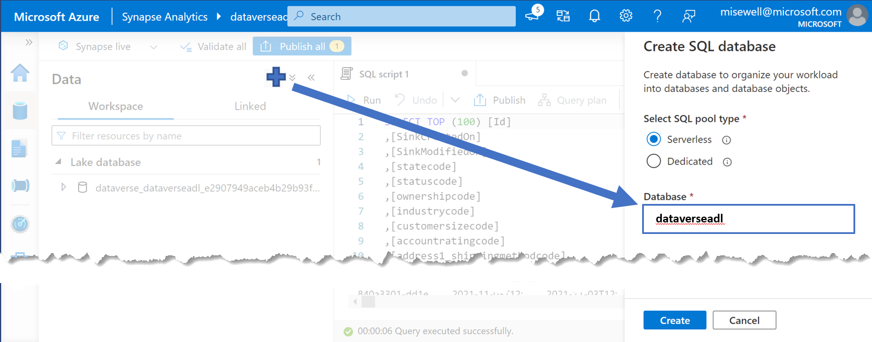
Create a companion Serverless SQL Database for Views
The ServerlessSQL DB auto-created by the Synapse Link is read-only.
Although you could point PowerBI directly to it, creating a 2nd ServerlessSQL DB to hold your own configured views for reports give you flexibility to create a simpler and ‘cleaner’ data source.
Azure Synapse Analytics – ServerlessSQL
Azure Synapse Link for Dataverse
Azure Data Lake Storage
Custom Report Views
Auto-Created Views

Slide 45
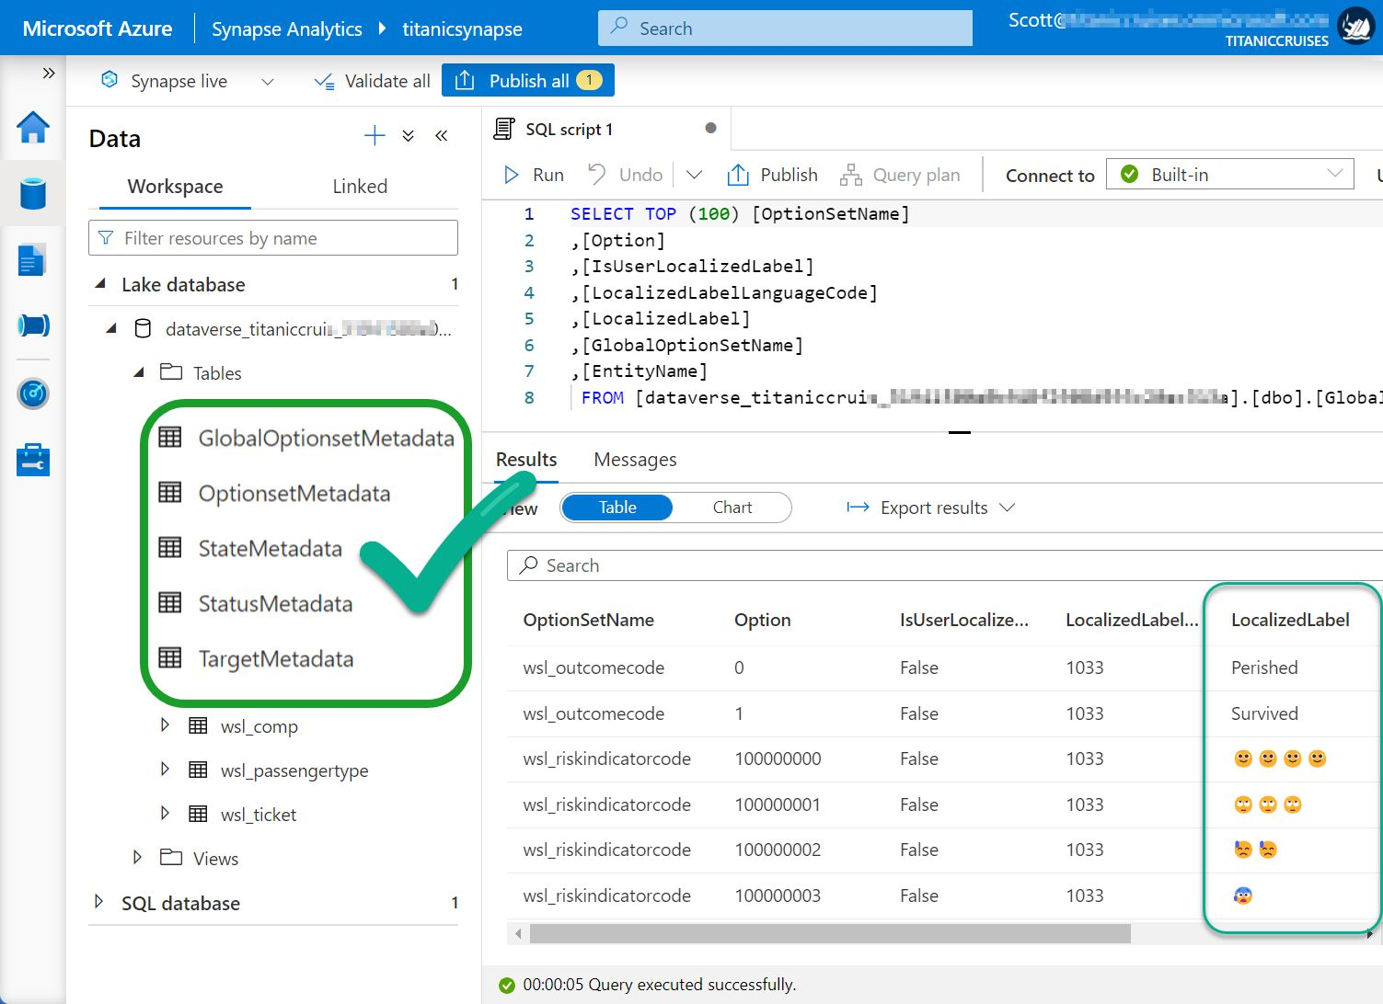
Use the metadata views to access the “Choice” Labels from Dataverse
The auto-created table views only return the numeric value associated with ‘Choice’ fields, State Code or Status Reason.
In a view, join the base table to the appropriate Metadata table to retrieve the needed label.
Documentation is here: Access Dataverse choice labels directly from Azure Synapse Link for Dataverse - Power Apps

Slide 46
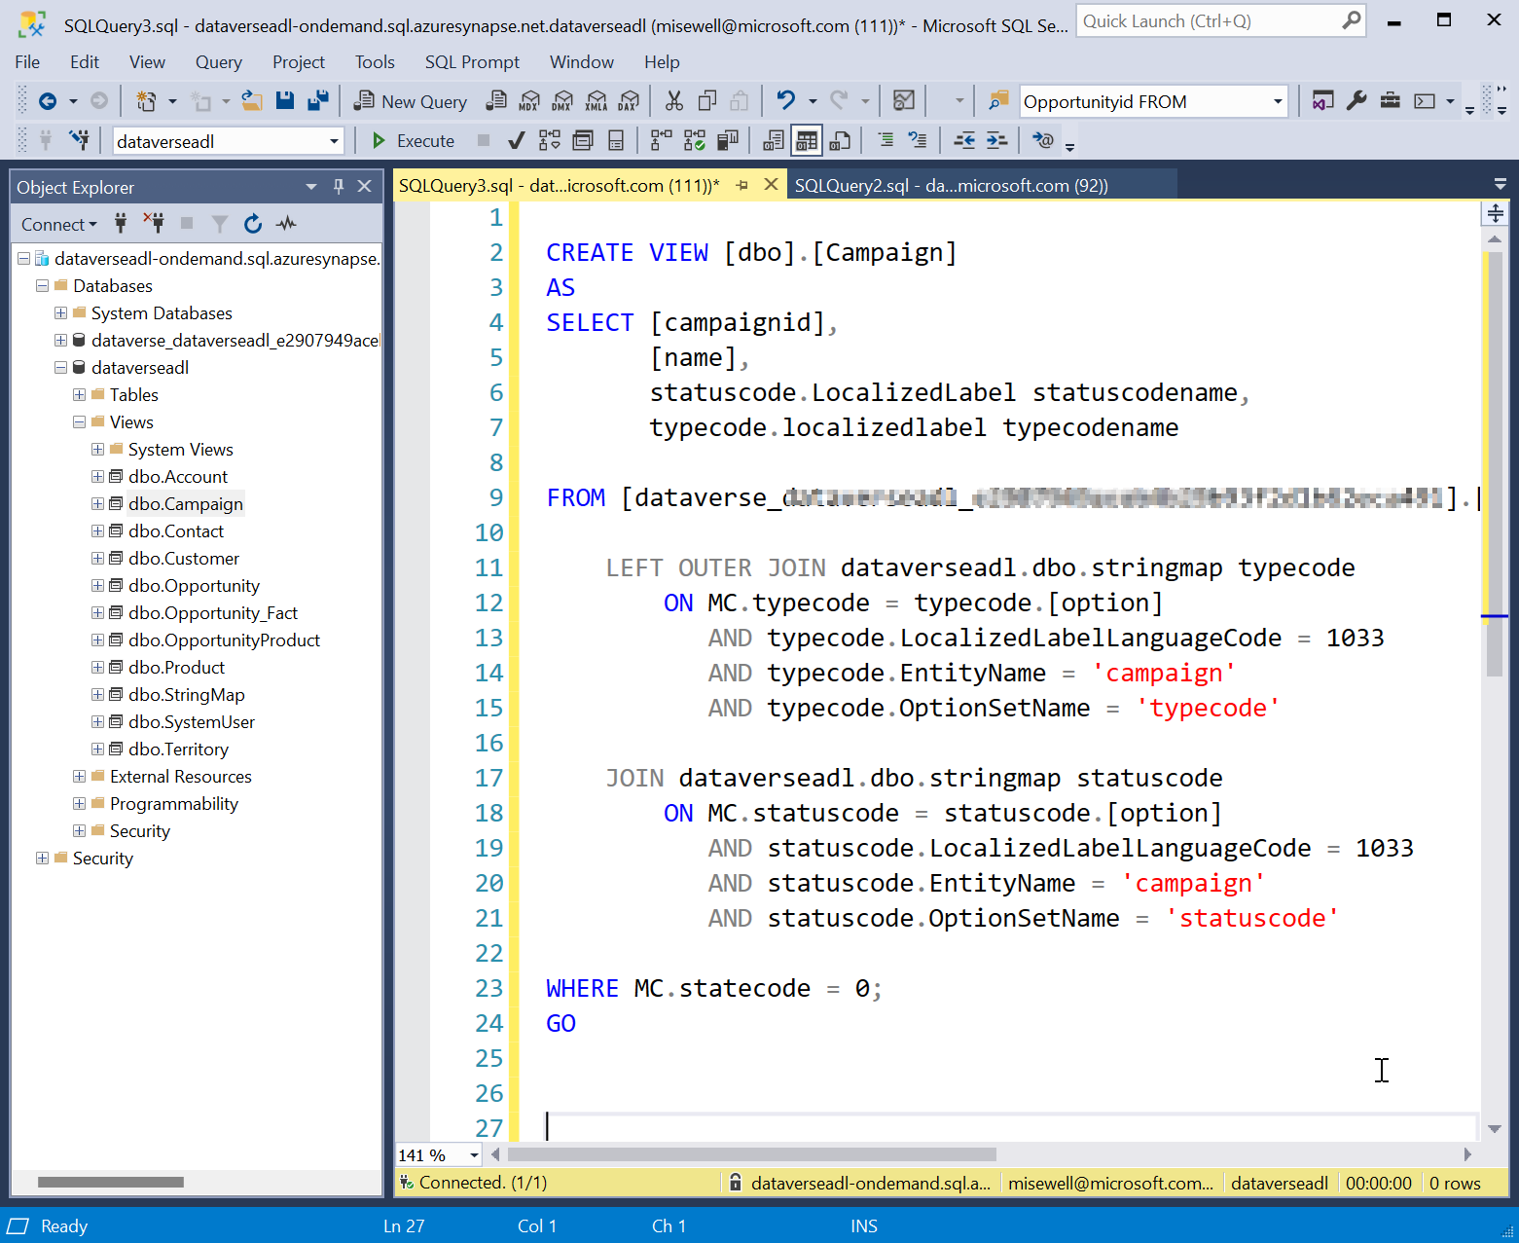
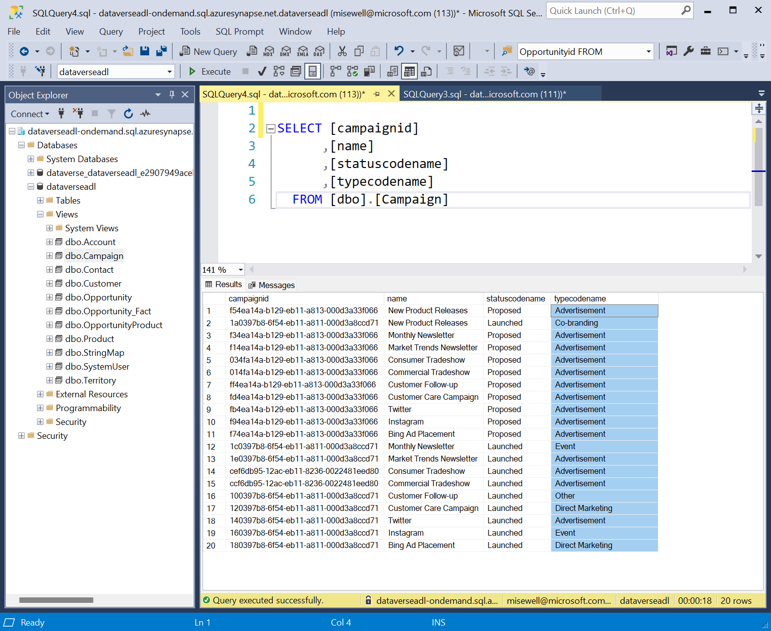
Create views for use as your report source.
Remove unneeded records and columns. Use the metadata views to resolve the choice labels and make it easier for your builders.

Slide 47
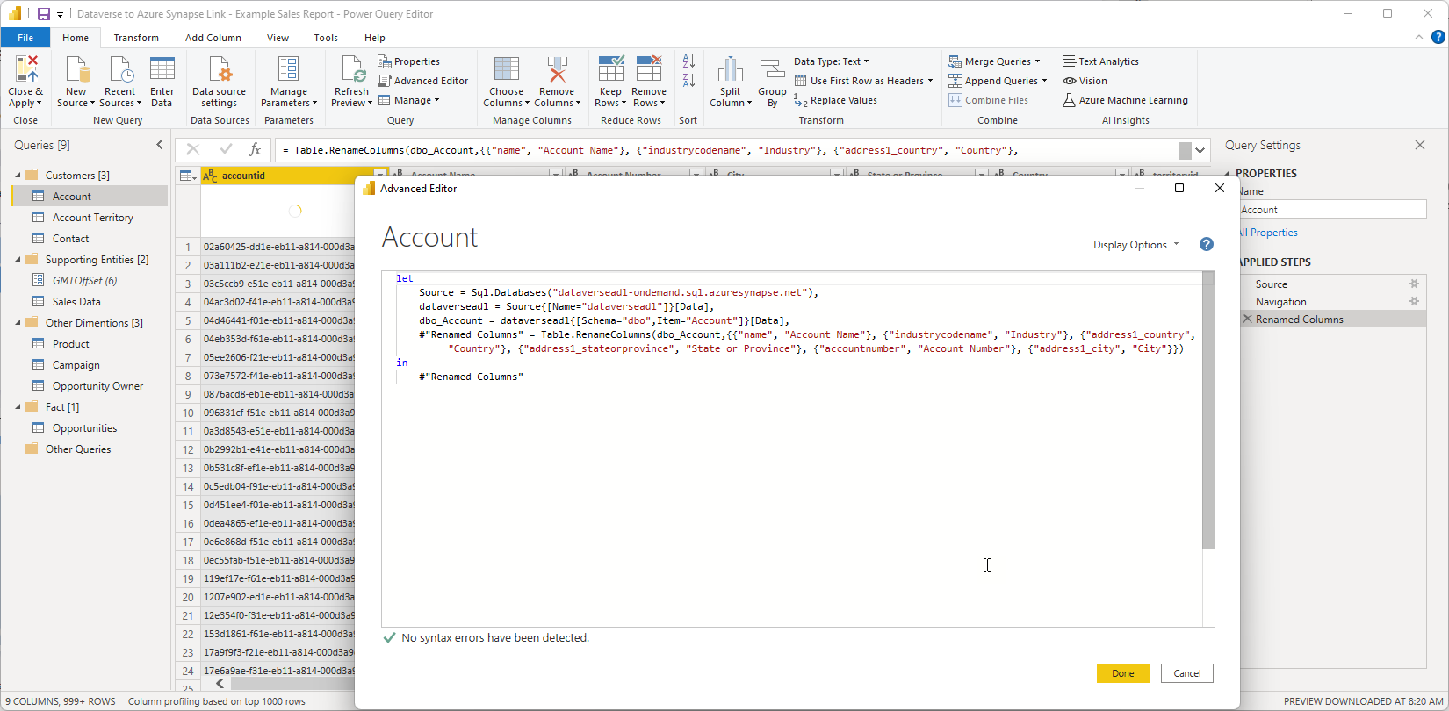
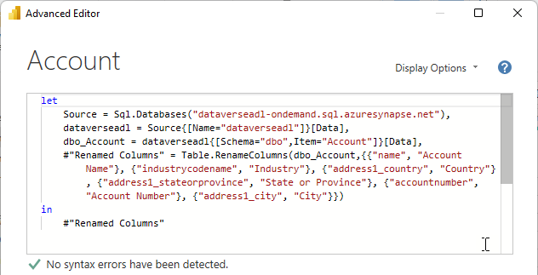
Connect Power BI to the newly created views

Slide 48
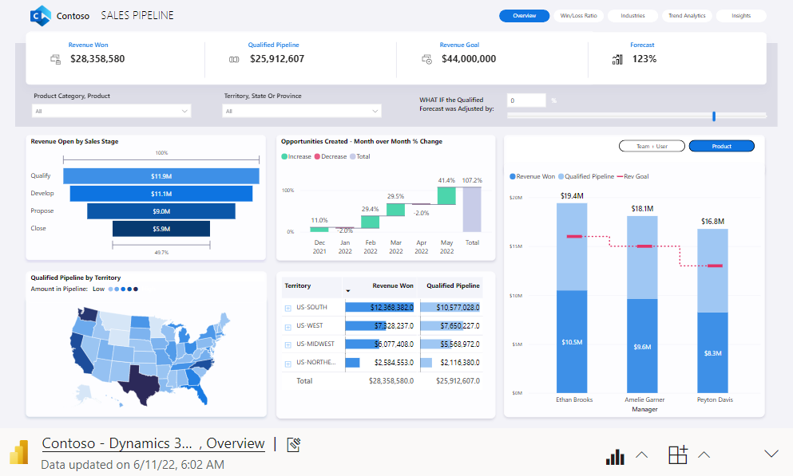
Completion of Basic Connectivity
Azure Synapse Link for Dataverse
Azure Synapse Analytics – ServerlessSQL
Auto-Created Views
Custom Report Views
Azure Data Lake Storage

Slide 49
Azure Synapse Link for Dataverse
Benefits:
Getting the Dataverse data to start flowing to the Azure Data Lake is a matter of clicks.
Considerations:
Azure Data Lake and Azure Synapse Analytics are billed on an Azure subscription.
Comes with a serverless SQL pool endpoint you can query with T-SQL.
Works as a data warehouse
Large volumes and complex query support in Synapse for additional data support and enrichment.
Once the data is out of Dataverse, the configured security model is lost (need to add Row Level Security).
If the customer hits Read/Write contention, there is a private preview for enabling an hourly snapshot for reading and other enhancements in the planning stage.
Date-Time is in UTC format

Slide 50
Q: Which connection is ‘right’ for my use case? A: It depends.
Criteria/Complexity
Dataset query result size | Dataverse – 80mb per Query | Azure Synapse – Massive
Query complexity | Dataverse – Power Query / SQL | Azure Synapse – Spark, SQL etc.
Data mash-up flexibility | Dataverse + Power Query | Azure Synapse Data Warehouse
Latency / Delay of data availability | Dataverse + DirectQuery Real time results | Azure Synapse Near Real-time or Hourly Snapshots
Effort to implement user context | Dataverse + DirectQuery Inherits Existing Security | Azure Synapse Row-Level Security in Power BI
Lower
Higher

Slide 51
Resources

Slide 52
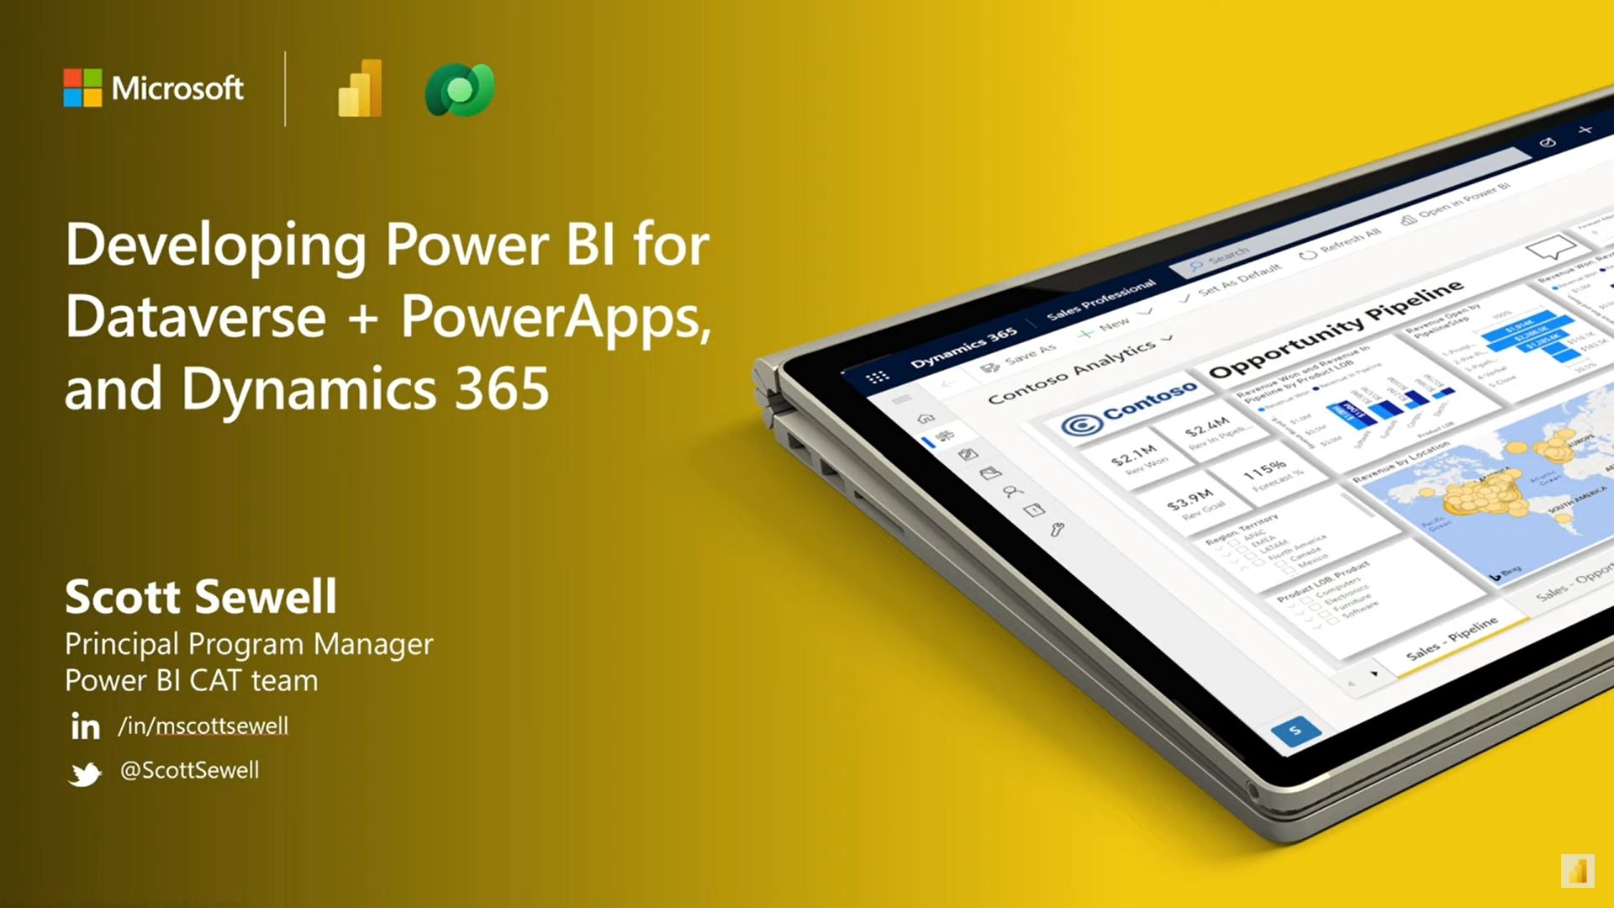
Developing Power BI for Dataverse + Power Apps
YouTube: Hands-on presentation for Power BI Dev Camp https://www.youtube.com/watch?v=9ZGpK2waM5Y
Power BI PBIX template reports https://github.com/PowerBiDevCamp/Camp-Sessions/tree/master/PBIX
PowerPoint deck: https://github.com/PowerBiDevCamp/Camp-Sessions/raw/master/Session%2014%20-%20Power%20BI%20with%20Dataverse.pptx

Slide 53
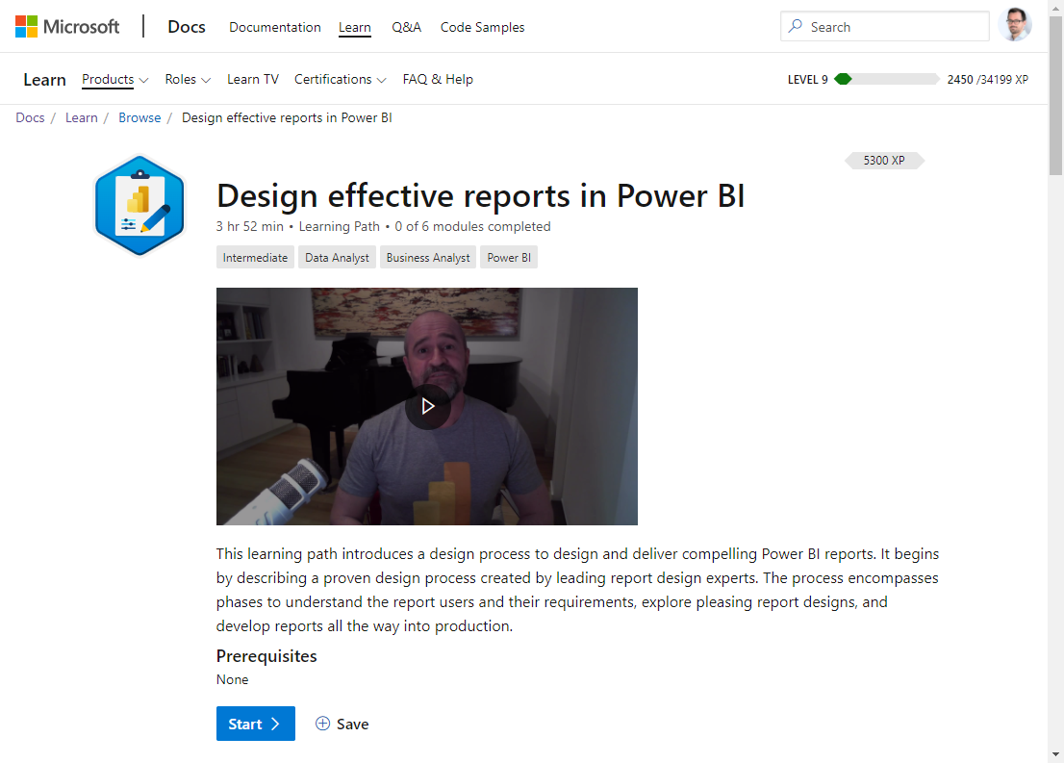
Microsoft Learn: design effective reports in Power BI
https://docs.microsoft.com/en-us/learn/paths/power-bi-effective/
Just like designers are rarely developers, developers are rarely aesthetically gifted designers – but delivering an un-designed (or poorly designed report) is almost never an effective result for the end-user.
The needed skill can be learned and applied by following a straightforward process to design and deliver compelling Power BI reports.
Proven design process created by leading report design experts.

Slide 54
Microsoft Docs
Use SQL to query data (link)
How Dataverse SQL differs from Transact-SQL (link)
Use Power BI with Dataverse
Overview (link)
View table data in Power BI Desktop (link)
Power Query Dataverse connector (link)
Embedding Power BI into Power Apps
Create or edit a Power BI embedded system dashboard (link)
Add or edit Power BI visualizations on your dashboard (link)
Embed a Power BI report in a model-driven app main form (link)
Power BI tile control in Power Apps (link)
Embedding Power BI into Dynamics 365 Finance and Operations apps
Analytical Workspaces (using Power BI Embedded) (link)
Power BI Embedded integration (link)
Customize embedded reports in analytical workspaces (link)
Power BI DirectQuery
DirectQuery model guidance in Power BI Desktop (link)
DirectQuery model troubleshooting in Power BI Desktop (link)

Slide 55
As a Dynamics/Power Apps/Dataverse Expert: Why should I care about this?
Expand the usability and value of your apps
Add a 360º overview for users / managers
Dataverse data – Without 50K row limits
External data – Combine without lift-and-shift
Contextual Reports
360º View from within an individual record
Your app becomes the go-to source.
Finally – The real benefit:
Dataverse is the best way to expose the value of the data in your app to Business Decision makers
Increase speed and completeness of adoption
Built-in Artificial Intelligence over your data

Slide 56
Thank you! https://github.com/mscottsewell/PowerBI-Dataverse

Slide 57
Thank You to our Sponsors…
Event Sponsor
Platinum Sponsors

Slide 58
Thank You to our Sponsors…
Gold Sponsors
Data Quality
Event Lunch
Accessibility
Data Analytics

